Slide 1
Title slide + image
Sample-Efficient Reinforcement Learning for Flight Control
Fault-Tolerant Flight Control | Wing Chan
Notes:
Hello everyone and welcome to my thesis presentation titled sample-efficient reinforcement learning for flight control.

Slide 2
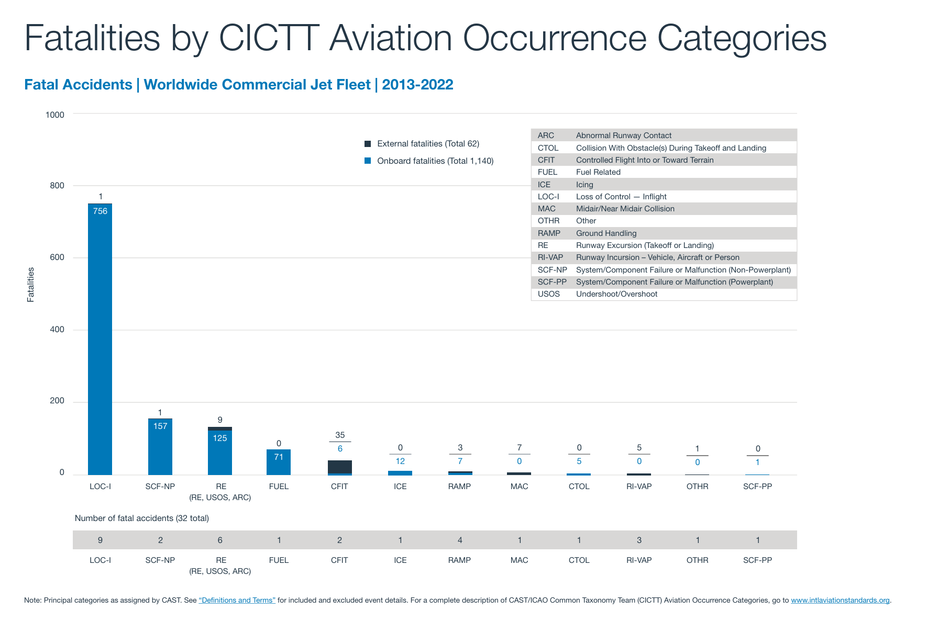

Make Flying Safer?
Deaths per 100 million passenger miles in the US:
Cars: 0.54
Railroad: 0.03
Buses: 0.004
Airlines: 0.001
LOC!
Notes:
I would like to begin by telling you about how safe aviation is.
Aviation has a pretty excellent safety record. But, if we group the fatalities from air travel according to their causes, the primary cause by far is due to Loss of control incidents. These are incidents caused by events ranging from in flight damage to the aircraft, sudden adverse weather conditions, to stalls. And this is a pretty big low hanging fruit! If we manage to design future flight control systems to become more fault tolerant so that they can handle such events, flying would be made quite a bit safer! And this, is one of the main goals that I would like to contribute to by carrying out this thesis.
Sources:
https://injuryfacts.nsc.org/home-and-community/safety-topics/deaths-by-transportation-mode/
statsum.pdf (boeing.com)

Slide 3
Contents
Create/edit a Hyperlink TO A SLIDE
1
Go to the tab ‘Insert’ and click on the button ‘Shapes’. Choose the shape ‘Rectangle’ and drag the mouse over the slide to create a shape.
Shapes
2
Drag the shape over the menu button and scale the shape as large as the button. Click with the right mouse button on the shape and choose ‘Edit shape’.
Size and position…
Edit shape…
3
Click on the paint bucket icon, click on ‘Shape Fill’ and drag the ‘Transparency’ slider to 100%. Now the shape is completely transparent.
01
02
03
04
05
Objective
Background
Methods
Results
Conclusion
Transparency
100%
4
Click on the transparent shape and use the shortcut Ctrl + K to add a hyperlink. At the left side of the window, click on ‘Place in this document’ and select the preferred slide
in the list. Then click on ‘OK’.
5
Copy the transparent shape and repeat
step 4. Do this for all menu buttons.
Want to know more?
Go to the tab 'SLIDEBUILDER’ and click
on the button ‘Inspiration'
Inspiration
Notes:
Now to give an overview of the presentation today, it will be divided into 5 sections.
1- motivations and objectives of this thesis.
2- the background theory needed to understand the topic of reinforcement learning for flight control.
3- the reinforcement learning algorithm I used and propose several augmentations to be experimented with.
4- experiments will produce results, which will be presented in the 4th section,
5- and finally, in the last section, these results will be used to answer some research questions.

Slide 4
Chapter | dark mode
01
Objective

Slide 5
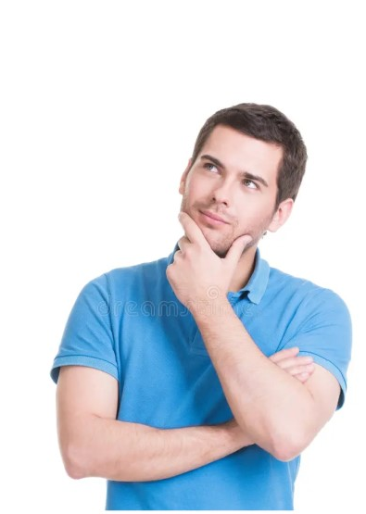

Pause
But first … why?
Notes:
Why reinforcement learning for flight control? Why did I choose this specific combination of topics?

Slide 6
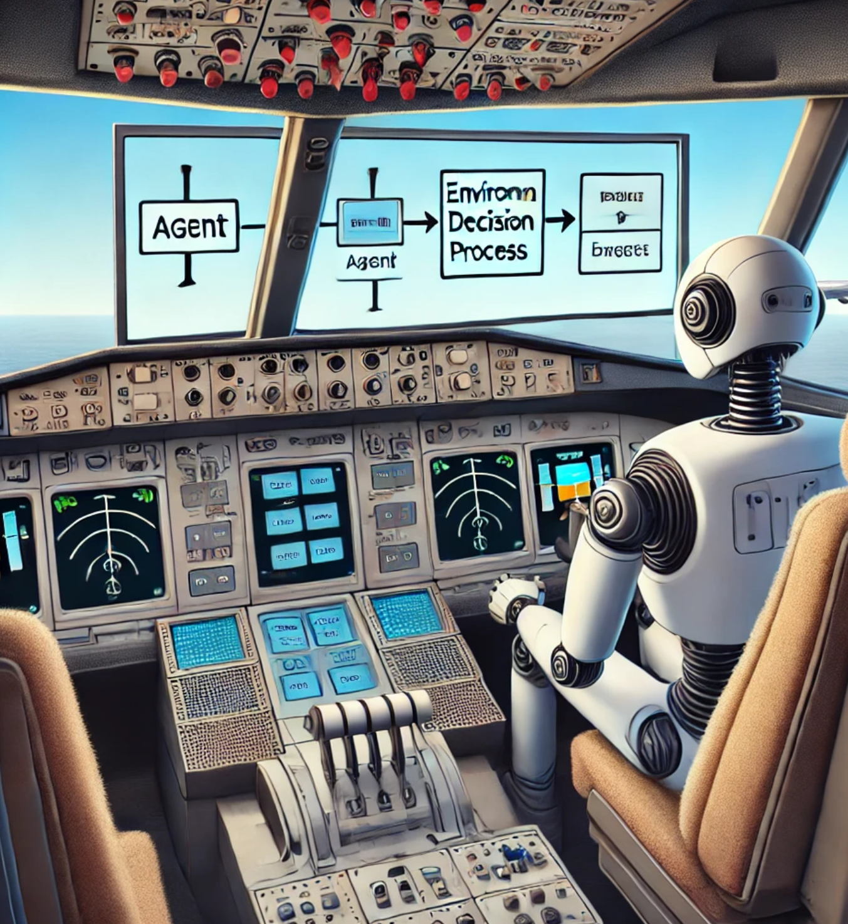
Motivations
    Why I chose reinforcement learning for flight control.
        Practical Reasons
            Fault tolerance
            Adaptive control
            Less model dependence
        Personal Reasons
            Technological enthusiasm
            … need to graduate
Notes:
There are several reasons, which can be grouped into practical and personal ones. The first practical reason is that this combination holds promise for fault tolerance, as demonstrated by a number of papers published from this very faculty. And this is thanks to the adaptive nature of reinforcement learning algorithms, since unlike other control methods their parameters can learn to adapt to the situation at hand. Last but not least the controllers made as a result become what are known as model-independent controllers, meaning creating these controllers is not contingent on having mathematical models of the aircraft you would like to control.
Aside from these, there are also personal reasons. And by far, the most important of which to me is my enthusiasm for the technology of reinforcement learning. Because I find it very exciting that with by distilling what we know about how animals learn through trial and error into some equations, and cleverly configuring these equations to feed into one another, that we can create programs which appear smarter the longer it interacts with the world.
And then theres also the reason which may be obvious to some of us in this room: I need to graduate. Because apparaently I cant walk out of this building without having chosen a thesis.
8 years ago, in March 2016, an RL algorithm bested the best human player in the board game Go. Years later, an improved version of the same algorithm became one of the best players of the computer game StarCraft 2… what next?

Slide 7
Research Objective
    To improve the fault-tolerance of RL based flight controllers by advancing the state of the art, through researching novel augmentations to reinforcement learning algorithms
Notes:
And anyways, so began my thesis journey. The objective which I arrived at for my research is as follows: …

Slide 8
Research Questions
    Dissecting the research objective, we have the following research questions:
1. What promising reinforcement learning algorithm for fault-tolerance and tracking performance should be further studied in the present research?
2. How can the identified algorithm be applied to control the PH-LAB research aircraft?
3. How does the developed flight controller perform during nominal flight and in the presence of faults?
Notes:
Then, to narrow down the objective into something specific enough to guide my work, I came up with 3 research questions. Each one of which nicely demarcates one part of my thesis.
The first is to learn about reinforcement learning, since when I first began this thesis I had no knowledge of any theory behind this title. Moreover, this is also where I look to choose an algorithm as well as how it can be improved.
The second question is related to the implementation, and that is to understand how exactly reinforcement learning algorithms fit into the problem of flight control.
The last is to evaluate how the flight controller implemented from this thesis perform from the perspective we were concerned with at the beginning: their fault tolerance.

Slide 9
Chapter | colour mode
02
Background

Slide 10
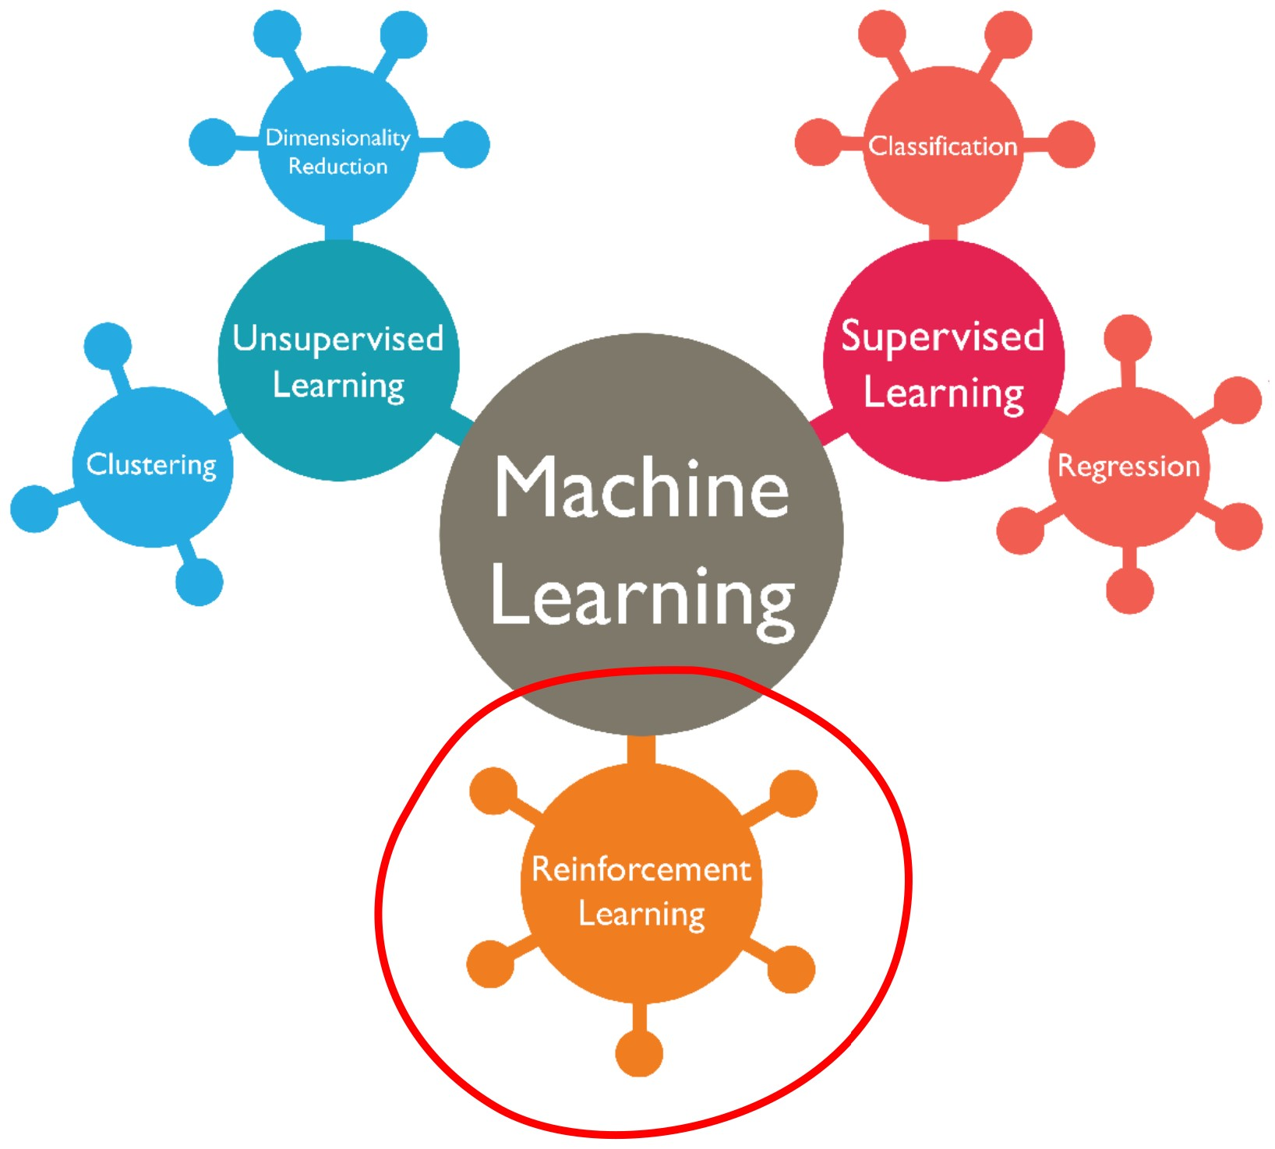
Reinforcement Learning
What is reinforcement learning?
  The field of machine learning algorithms which learn to maximize expected reward through repeated interactions with the environment
Image by: Abdul Wahid
Notes:
To start with, I’ll tell you a little bit about how reinforcement learning works.
Reinforcement learning is one of the three sub-fields of machine learning,
Reinforcement learning: algorithms learn how to behave in an environment through repeated interactions, like learning to ride a bike
Supervised learning: algorithms learn to label data given a set of prelabelled data, look at a thousand pictures of dogs to learn what a picture of a dog looks like, like flash card learning.
Unsupervised learning: algorithms try to detect patterns in a set of data, give you a basket of oranges and bananas, you would recognize that some of the things inside this basket are pretty round, while some other things inside this basket are pretty long, so maybe there are two kinds of things inside this basket and I should group them differently.
Picture by Abdul Wahid Big data and machine learning for Businesses | PPT (slideshare.net)

Slide 11
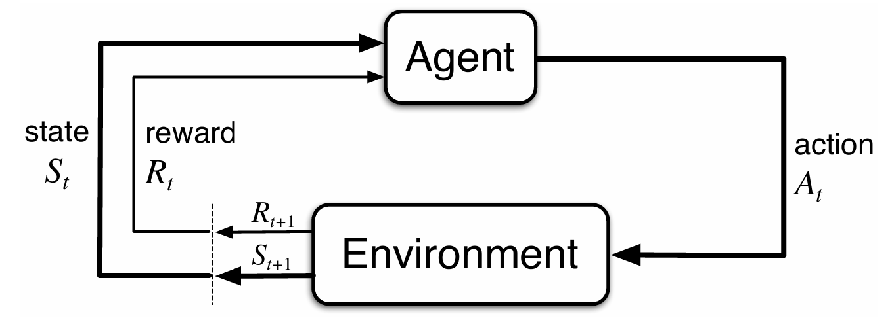
Reinforcement Learning
How do we make algorithms which can learn? First define a useful framework.
Markov Decision Process (MDP):
Mathematical framework to model discrete time sequential decision-making processes.
  State Space:
Set of all possible configurations (states) which the environment or system can exist in.
  Action Space:
Set of all possible actions which can be performed.
  Reward Signal:
Variable defining how optimal a given state is.
Notes:
A Markov decision process, or MDP, is a mathematical …. An MDP can be represented using this diagram we have here. In MDP’s, we have an agent which interacts with the environment and gets some feedback. At each time step, the agent observes the state of the environment and some reward signal, which it uses to determine an appropriate action to take on the environment. The environment then reacts by producing the next timestep’s states and rewards, and the cycle continues. That cycle I have just described is an MDP.
Defining an MDP requires a few things, aside from creating the agent and the environment, the three other important things to define are:
The State space, which is the set of …
The Action space, which is the set of ….
And finally the Reward signal, which indicates how good or optimal a state is.
Definition of states/state space, to be made more specific when we talk about flight control!!

Slide 12
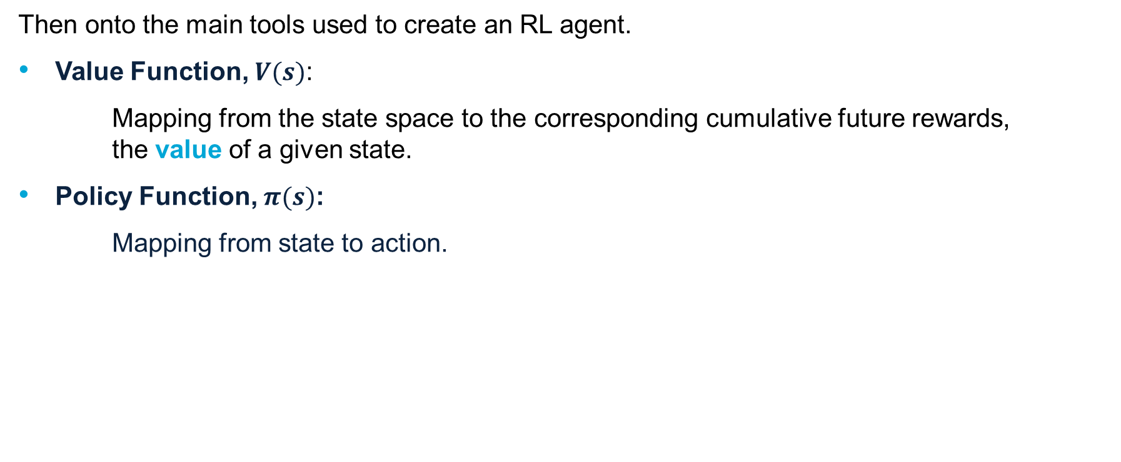
Reinforcement Learning
Then onto the main tools used to create an RL agent.
Value Function, $V(s)$:
Mapping from the state space to the corresponding cumulative future rewards, the value of a given state.
Policy Function, $π(s)$:
Mapping from state to action.
Model (optional):
A variable or function capturing the state dynamics of the environment.
Notes:
mouse maze example!
So that’s the framework we use, but now how do we make an RL agent?
Definition of value function is somewhat misleading here, the one given is for the state value function, but there also exists an action value function.
The model function is optional, and the whole catalogue of reinforcement learning algorithms can almost be perfectly divided into ones which use a model, and ones which do not; so called model-based RL and model-free RL.

Slide 13

Reinforcement Learning
What algorithm to use? How many are there to choose from?
Answer: Quite a few
Algorithm Characteristics:
Model-Based vs Model-Free
Value-Based vs Policy-Based
On-Policy vs Off-Policy
Short-listed Algorithms:
SAC, Haarnoja et al. 2018
TD3, Fujimoto et al. 2018
IDHP, Zhou et al. 2018
Notes:
If I listed all the algorithms I came across in my literature study it would probably take multiple slides.
But at the very least lets see the groups which all these algorithms fall into
Model based vs free, whether a model is used to help the agent learn
2. value vs policy, whether the agent solely learns a value function and uses a simple static policy, or If the agent learns only a policy function without keeping track of the value function.
Third would be on vs off policy, in on policy algorithms the policy or value function which dictates the agent actions is the same as the one being updated or learnt, while in off policy algorithms the two would be distinct, the policy or value function dictating the action is not the one being updated.
Value-Based vs Policy-Based: The distinction between value and policy-based is what the algorithm is designed to estimate. When the algorithm is value-based, it trains an estimate of the optimal value function from which the actions are inferred; versus in the policy-based case, where an estimate of the optimal policy function is trained from which actions are directly obtained. Policy based algorithms learn a policy without consulting a value function
On vs Off policy refers to if the policy which an agent uses to execute actions is the same policy which is being trained. If it is on policy, then both are the same, but if it is off policy, then they are not.
After some research, a couple of algorithms seemed to be most commonly mentioned and used, and these are SAC, TD3, and IDHP. These are some algorithms which have been used for flight control in the past and shown pretty promising results
So out of these algorithms, which one would be the most promising to move forward with?

Slide 14
Reinforcement Learning
What would be a fault-tolerant controller? Consider that faults are:
Unexpected in time
Unexpected in form
Great option:
An online-learning algorithm => Enabling adaptive control
Short listed algorithms:
SAC
TD3
IDHP
Notes:
For that, we can refer back to our research objective and think about which algorithm would potentially make the most fault tolerant controller. So, considering that faults are…
Both SAC and TD3 are off-policy algorithms which work best with deep neural networks which takes a long time for convergence, while IDHP is of an on-policy nature which makes in converge faster, fast enough to execute training online.
IDHP on the other hand converges quickly, while SAC and TD3 algorithms in literature take around half a million simulation steps to converge, translating to 1 to 2 hours of flight time, IDHP takes around 1000 times less steps at a flight time of around 5 to 10 seconds.
So if we keep in mind these two characteristics of faults, and the advantages which adaptive control systems provide in the face of these characteristics, the online learning nature of IDHP makes it a strong candidate, and that is what I have chosen to move forward with in this thesis.

Slide 15


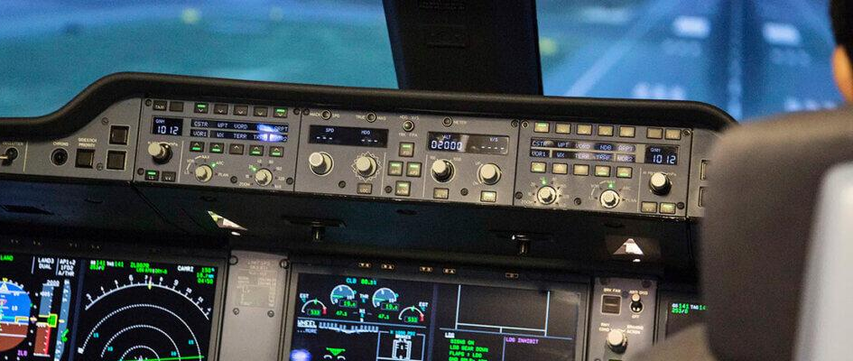
Automatic Flight Control
    Commonly referred to as the Autopilot, technically referred to as a controller.
        How automatic flight control works:
Altitude, Heading, Speed
Control inputs
Sensors
Autopilot
Notes:
Now that we’ve selected an algorithm, lets see how it can be applied to flight control.
We begin by looking at how an automatic flight control system works through this diagram
The whole system revolves around the autopilot/flight control computer. The human pilot controls the aircraft through this autopilot, by setting the states that he wants the airplane to fly at, for example what velocity, or what altitude. The autopilot then takes these commands, referred to as the “reference signal”, compares them to sensor readings of the aircrafts current states, and computes what control inputs to give to the aircraft.
While in modern autopilots, the flight controller is created using methods from mathematical theory. What we do in this thesis is to use reinforcement learning theory.

Slide 16
RL for Flight Control
    Integrating RL algorithm into flight control = integrating auto-pilot into flight control.
Sensor,
Command
Tracking error
Autopilot
Control command
&
Notes:
This substitution can be done rather easily, by reframing the MDP as a flight control task. Taking a look at this MDP diagram from earlier, we have the:
Agent becoming the autopilot
Environment becomes the pilot and the aircraft
State becomes sensor readings and pilot commands
Reward becomes the tracking error
Action becomes the control commands
By making these substitutions, we can directly integrate any reinforcement learning algorithm developed by the research community into an automatic flight control system.

Slide 17
Chapter | dark mode
03
Methods
Algorithm & augmentations
Experiments
Notes:
time around 15 minutes

Slide 18
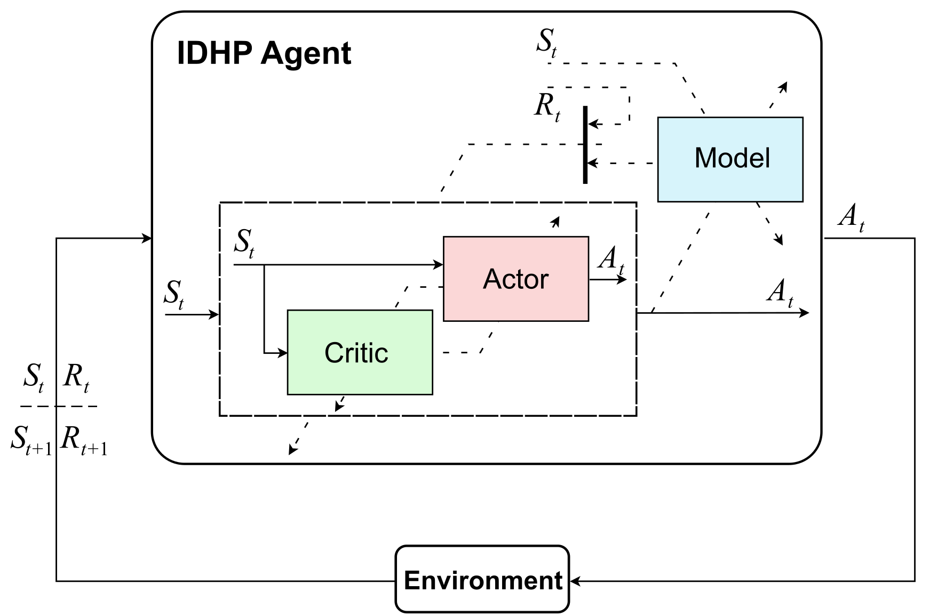
IDHP
Incremental Dual Heuristic Programming
Incremental:
Model represents state increments.
Dual:
Critic estimates Value gradients.
Heuristic:
The critic is a heuristic estimate of the value function gradient.
Programming:
Referring to the dynamic programming origins.
Notes:
1. IDHP stands for ….
2. The way the algorithm works is as follows, first the state observation is fed to the actor, which computes the agent’s action, alongside with an update for the critic. The critic then uses the state observation to compute an update for the actor. Then, the model in conjunction with the observed reward to update the actor and the critic. And finally, the state observed alongside the actors action is used to update the model.
Applying all these updates represents one agent learning step, and in the next time step the process is repeated again.

Slide 19

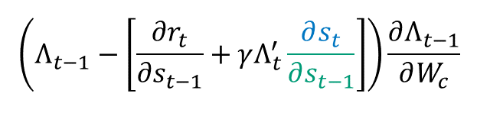
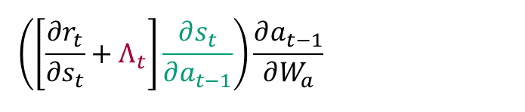
IDHP: Update equations
Actor, $W_{a}$:
$$W_{a_{t+1}}=W_{a_{t}}+η_{a}\frac{∂R}{∂W_{a}}$$
Critic, $W_{c}$:
$$W_{c_{t+1}}=W_{c_{t}}−η_{c}\frac{∂TD}{∂W_{a}}$$
Model, $Θ$:
Update using RLS, $Θ_{t+1}=Θ_{t}+ΔΘ_{RLS}$
$$\left(\left[\frac{∂r_{t}}{∂s_{t}}+Λ_{t}\right]\frac{∂s_{t}}{∂a_{t−1}}\right)\frac{∂a_{t−1}}{∂W_{a}}$$
$$\left(Λ_{t−1}−\left[\frac{∂r_{t}}{∂s_{t−1}}+γΛ_{t}^{′}\frac{∂s_{t}}{∂s_{t−1}}\right]\right)\frac{∂Λ_{t−1}}{∂W_{c}}$$
Notes:
The key defining features of a reinforcement learning algorithm are the update equations, or the way that the components of the agent are updated to help the agent learn. So I’ll briefly go over what they are in the IDHP algorithm.
Actor gradient ascents, critic gradient descents. Actors function is the return, it is to be maximized. Critic function is a cost (temporal difference error), it is to be minimized.
The update equations presented here defines the state of the art of the IDHP algorithm.
Gt = Rt+1 +gammaRt+2 +gamma2Rt+3 +···+gammaTRT, return is sum of future rewards
Animation needed, reveal line by line
In practice for the critic update, \partial r_t over \partial s_t-1 is replaced by \partial r_t-1 over \partial s_t-1, assuming linearity and high enough sampling rate. Slight abuse of formula ;)
Talk about how its a neural network
The black coloured terms are terms which either uses observations directly or doesnt rely on other components for computation

Slide 20
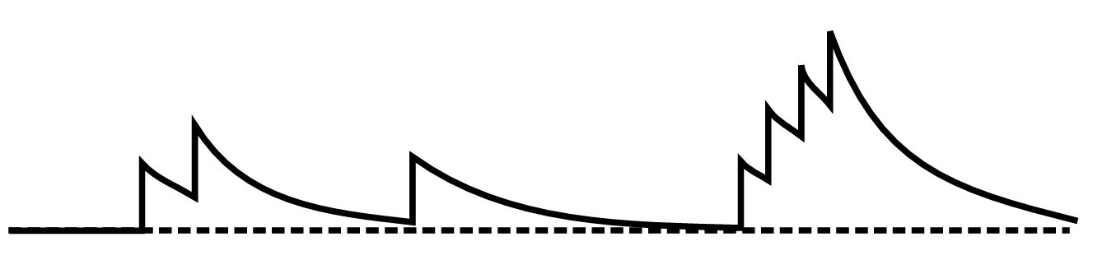
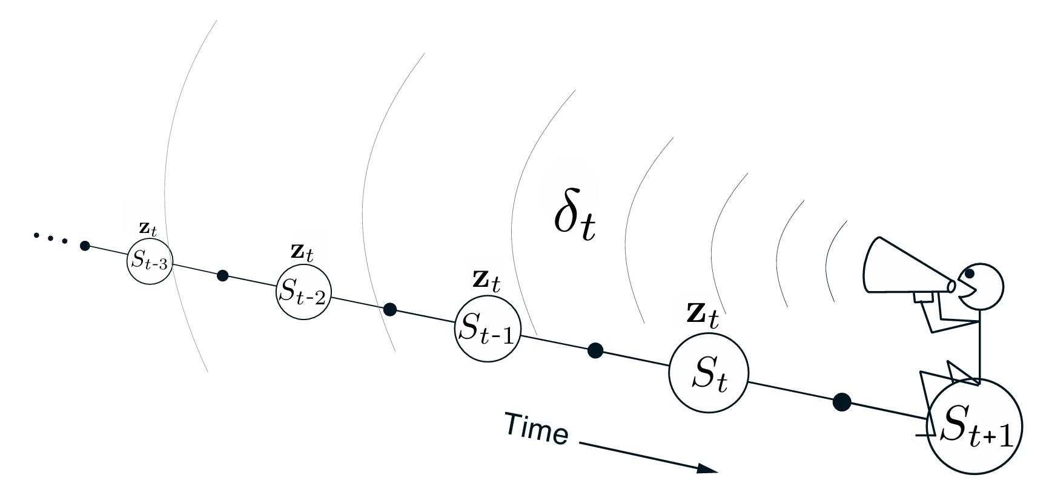
Augmenting the IDHP algorithm
    Idea: Faster learning, faster fault recovery. Can we increase learning rate of algorithms?
    Answer: Yes, use more prior information in the learning process.
    Cue Eligibility traces & Multi-step updates!
        What are they?
        Eligibility Traces:
        A trace of how eligible certain parameters are to updating.
        Multi-step updates:
        Using two or more timesteps of information for updating.
Images by: Richard Sutton, Andrew Barto
Notes:
Objective: improve existing algorithms!
As an objective of this thesis, I wanted to see what we can change in these equations in order to push the state of the IDHP algorithm forward. And so, I had the following idea: if we help the algorithm learn faster, then maybe it would also recover from faults faster, so would there be a way to accomplish this? Cue: elig and n-step.

Slide 21

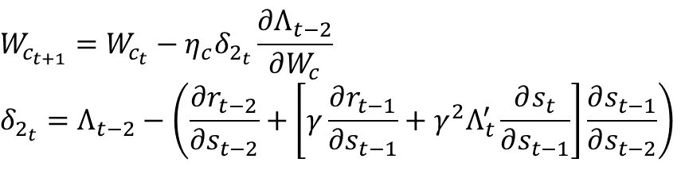
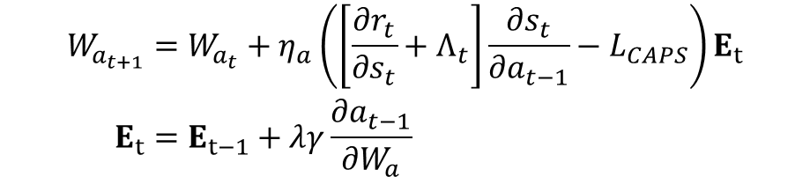
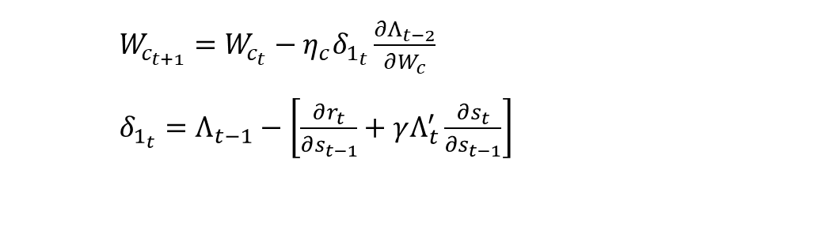
IDHP: Augmented Update equations
Actor, $W_{a}$:
Eligibility trace $\frac{∂a_{t−1}}{∂W_{a}}$ and smoothen action!
$$W_{a_{t+1}}=W_{a_{t}}+η_{a}\left(\left[\frac{∂r_{t}}{∂s_{t}}+Λ_{t}\right]\frac{∂s_{t}}{∂a_{t−1}}\right)\frac{∂a_{t−1}}{∂W_{a}}$$
Critic, $W_{c}$:
Multistep update, expand temporal difference term
$$W_{a_{t+1}}=W_{a_{t}}+η_{a}\left(\left[\frac{∂r_{t}}{∂s_{t}}+Λ_{t}\right]\frac{∂s_{t}}{∂a_{t−1}}−L_{CAPS}\right)E_{t} \\ E_{t}=E_{t−1}+λγ\frac{∂a_{t−1}}{∂W_{a}}$$
$W_{c_{t+1}}=W_{c_{t}}−η_{c}δ_{1_{t}}\frac{∂Λ_{t−2}}{∂W_{c}}$
$δ_{1_{t}}=Λ_{t−1}−\left[\frac{∂r_{t}}{∂s_{t−1}}+γΛ_{t}^{′}\frac{∂s_{t}}{∂s_{t−1}}\right]$
$$W_{c_{t+1}}=W_{c_{t}}−η_{c}δ_{2_{t}}\frac{∂Λ_{t−2}}{∂W_{c}}$$
$$δ_{2_{t}}=Λ_{t−2}−\left(\frac{∂r_{t−2}}{∂s_{t−2}}+\left[γ\frac{∂r_{t−1}}{∂s_{t−1}}+γ^{2}Λ_{t}^{′}\frac{∂s_{t}}{∂s_{t−1}}\right]\frac{∂s_{t−1}}{∂s_{t−2}}\right)$$
Notes:
Next lets see how the IDHP algorithm can be augmented.
For the actor, we will use eligibility traces to expand the gradient descent term and accumulate the neural networks gradients. Moreover, a cost term L is also added, so that now this gradient ascent term should not only increase future cumulative rewards, but also increase smoothness of the actor’s actions.

Slide 22
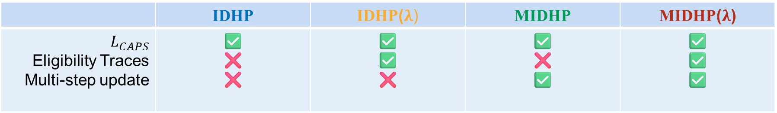
IDHP: Augmented Variants
 | IDHP | IDHP($λ$) | MIDHP | MIDHP($λ$)
$$L_{CAPS}$$ Eligibility Traces Multi-step update | ✅ ❌ ❌ | ✅ ✅ ❌ | ✅ ❌ ✅ | ✅ ✅ ✅
Notes:
IDHP with L_CAPS but not elig or ms, which I will call the baseline IDHP.
IDHP lambda, which is IDHP with eligibility traces
MIDHP, which is IDHP with multistep update,
And finally, MIDHP lambda, which is IDHP with both eligibility traces and multi-step update.

Slide 23
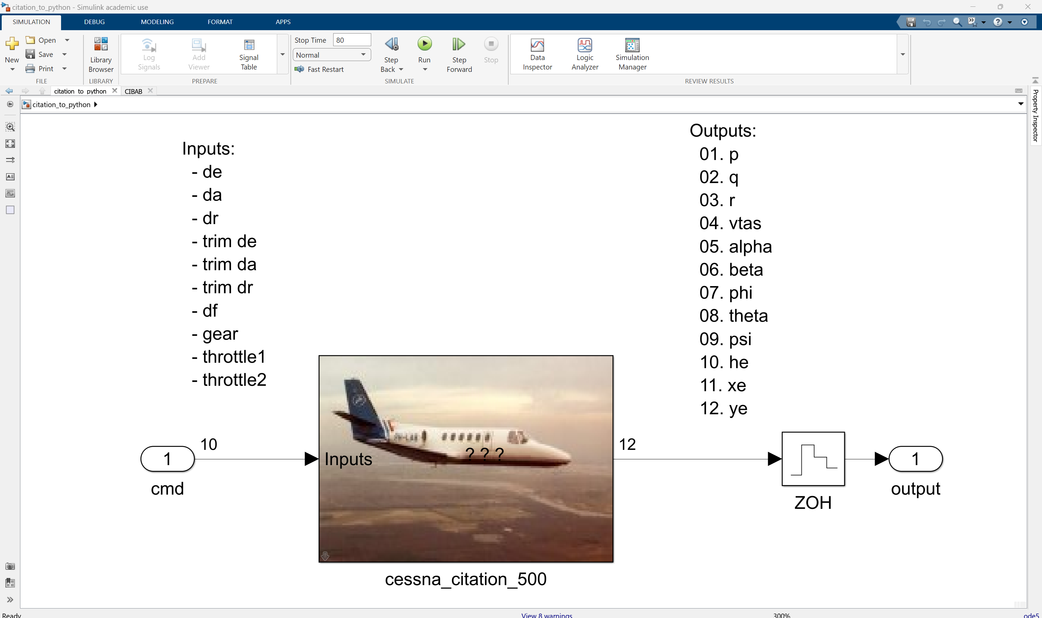
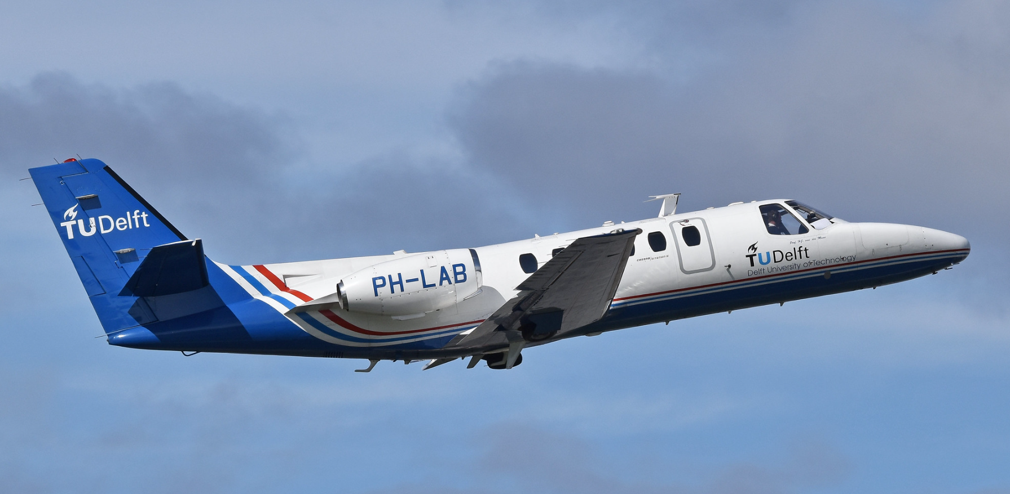
The Simulation Environment: the aircraft
    CitAST- Citation Analysis & Simulation Toolkit:
    A computational model of the PH-LAB Cessna Citation II, 6 DOF rigid body flight dynamics.
Notes:
The experiments conducted uses a computer model of a business jet, the Cessna citation 2.

Slide 24
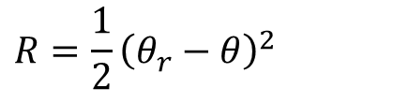
The Simulation Environment: the MDP
    States, Action, and Reward:
$$S={\left[ q α θ (θ_{r}−θ)\right]}^{⊤}$$
    $$X={\left[ p q r V α β θ φ ψ H X Y \right]}^{⊤} \\ U={\left[{ δ}_{e} δ_{a} δ_{r} tr_{e} tr_{a} tr_{r} δ_{f} gear T_{1} T_{2}\right]}^{⊤}$$
$A=$ $δ_{e}$
$$R={\frac{1}{2}\left(θ_{r}−θ\right)}^{2}$$
Notes:
This computer model simulates most of the aircraft states and actions.
But
In this thesis I aim to focus on studying the effect of the eligibility traces and multistep updates on IDHP, the simulated flights will be focused on handling the pitching motion of the aircraft. In other words, we will only investigate longitudinal pitch control. And so, we construct the MDP state space by only keeping the most relevant longitudinal states, in addition to adding the pitch tracking error. By observing these states, an RL agent should have a reasonably good picture of the aircraft in order to handle the flight control at hand, and accordingly learn to follow the reference pitch signal.
The action space of the MDP is created …

Slide 25
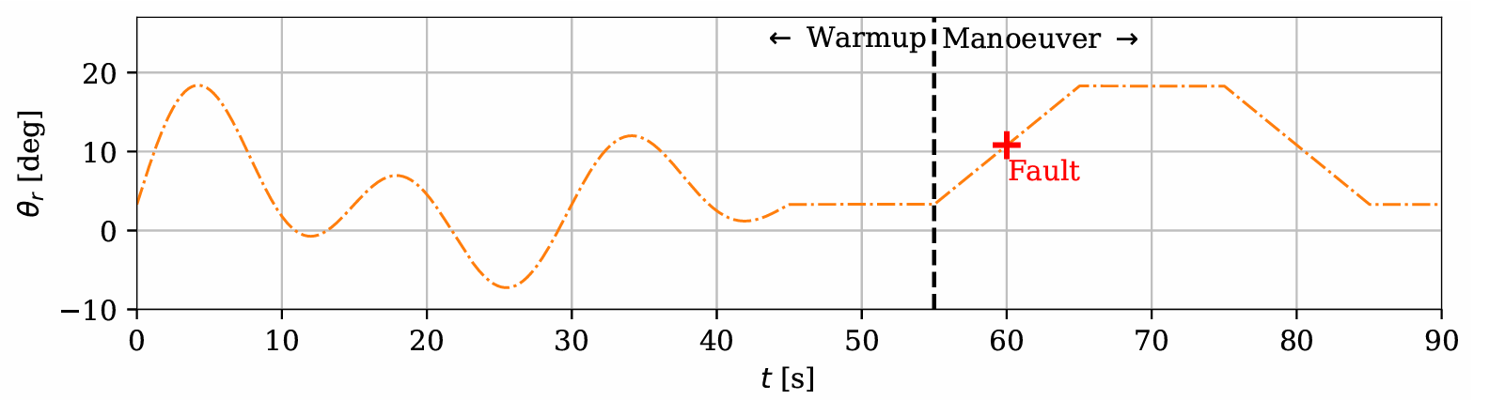
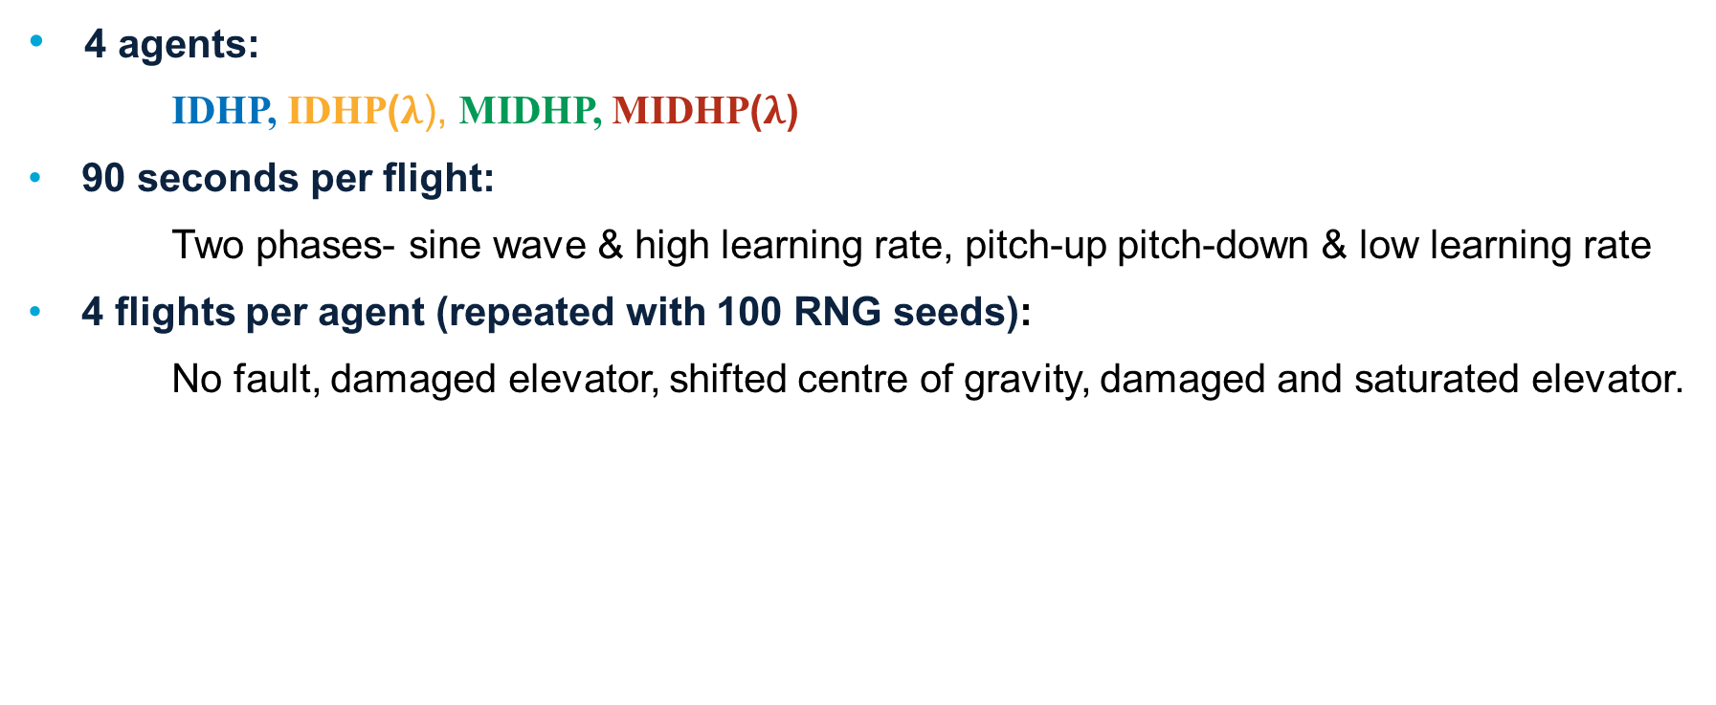
Simulated Flights
4 agents:
    IDHP, IDHP($λ$), MIDHP, MIDHP($λ$)
    90 seconds per flight:
    Two phases- sine wave & high learning rate, pitch-up pitch-down & low learning rate
    4 flights per agent (repeated with 100 RNG seeds):
    No fault, damaged elevator, shifted centre of gravity, damaged and saturated elevator.
Notes:
Using this environment, we will carry out some simulated flights with each of the agents.
The flights which they will perform lasts 90 seconds, and it is separated into two phases. At the beginning of the flight at the first phase, the agents are initialized from a blank slate with random neural network weights, and they are given a high learning rate which decays over time.
CLICK ANIMATION
During this phase, the agents are commanded to pitch the aircraft in a sine wave. Phase is called warmup, referring to the fact the agents start from a blank slate and has to warmup. After this comes a second phase, by this time the agents learning rates have decayed to a low but non zero number,
CLICK ANIMATION
and they are told to execute a pitch-up pitch-down maneuvre. For convenience, this phase is called the manoever phase.
So that’s one flight, and each agent will perform four of such flights repeated 100 times.
In the first flight, we introduce no fault at this 60 second mark. In the second, we damage the elevator at this mark, modelled by reducing the control effectiveness of the elevator by 70%. In the third flight, we change the balance of the aircraft by shifting it’s centre of gravity towards the nose by half a meter. And in the fourth flight, we both damage and reduce the maximum deflection of the elevator from its original 15 degrees to 5 degrees.
cg shift fault has the cg of aircraft moved towards nose by 0.5
Damaged elev reduces elevator control effectiveness by 70%
Saturated reduces max elevator deflection from 15 to 5 degrees.
While the manoeuvre flight profile (nose up nose down) is realistic, the pitch which the agents are told to hold is made extreme to “stress test” them.
typical Boeing 747 climb angle after take off is 6.2 degrees
For Cessna citation 2, its around 7.8 degrees
Total flight time was kept low to keep data generation times down.
90 seconds flight with some warm up and then executing a flight maneuver, think of this as giving some student pilot 1 minute of time with an airplane and then telling them to start flying some maneuvers, luckily for the student this maneuver will be pretty simple.
What the student pilot doesn't know is that suddenly during the maneuver, I am going to mess with the airplane, and the student has to adapt to that tom foolery.

Slide 26
Evaluations
    5 tests will be used to evaluate the agents.
    Metrics - Tracking error (RSE), Action smoothness (Sm)
    Test 1- RSE and Sm of each agent during warmup.
    Test 2- RSE and Sm of each agent during manoeuvre with no fault
    Test 3- RSE and Sm of each agent during manoeuvre with damaged elevator
    Test 4- RSE and Sm of each agent during manoeuvre with shifted CG
    Test 5- RSE and Sm of each agent during manoeuvre with damaged and saturated elevator
Notes:
These test flights will generate the data we need to evaluate how the eligibility trace and multistep augmentations affected the algorithms performance.
And we will do this comparison using the metrics of tracking error, in terms of the Root square error or RSE, which is one number that sums up the total tracking error across a certain time frame, the closer RSE is to 0 the lower the tracking error is. The second criteria we look at is the action smoothness of the agents, this is represented in the Smoothness or Sm value, which represents how smooth the action of the agent is across a certain time frame, the closer to 0 the smoother the action is.
With these two criteria, we will do 5 tests on the gathered data. The first is how do the agents compare during the warmup phase using the flight with no fault.
For test 2, we look at these two metrics for the no fault flight only during the manoeuver phase, so the last 35 seconds of the flight.
Test 3 is identical to test 2, with the only exception being now we look at the flight with a damaged elevator introduced at 60 seconds. And so on for the other 2 tests
And the next four is how do the agents compare during the manoeuvering phase.

Slide 27
Chapter | dark mode
04
Results
Notes:
At long last…

Slide 28
Results
    After flying 100 times… how did the agents do? How do they compare to one another?

Slide 29
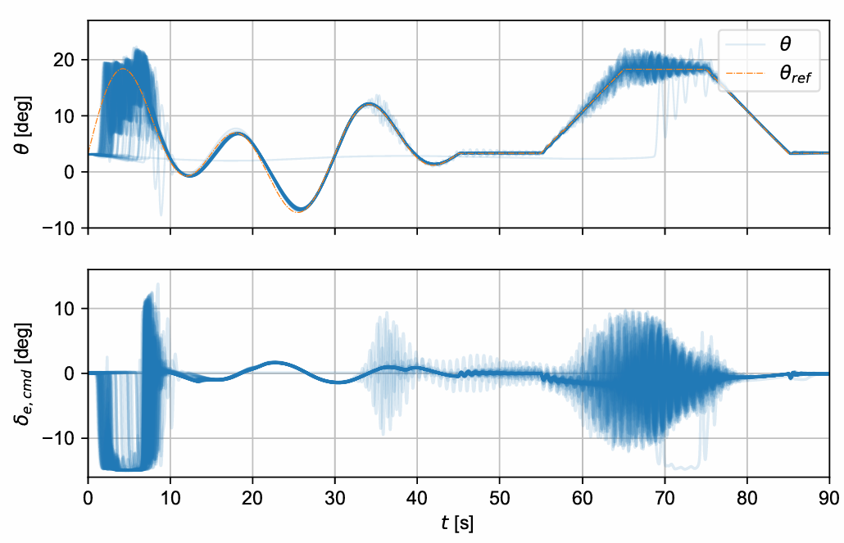


No fault
IDHP
IDHP($λ$)
Notes:
So lets look at the full 90 seconds flight with no fault is introduced (during the manoeuvreing phase).
left are the reps by the baseline idhp, right is idhp lambda, the top graph is pitch, bottom is elevator input, 100 thin blue lines are 100 repetitions of the flight
The baseline IDHP flies and learns a stable controller pretty well in the warmup phase. But, when the agent move to the Manoeuvre phase, and we ask it to pitch up to 15 degrees and hold, its actions start to become shakey, which lasts for most of the time while the nose is up, but goes away ones we command the agent to fly level again.

Slide 30
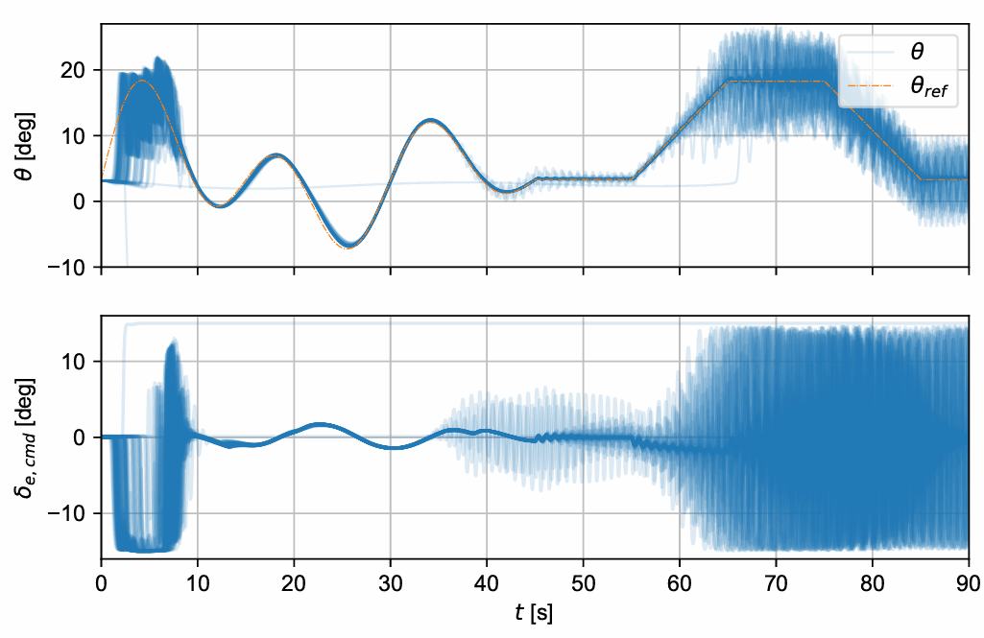
No fault
IDHP
MIDHP
Notes:
The policy which MIDHP arrives at here seems to be much more liberal at using the maximum and minimum elevator deflections, this is an indication that the controller is “high gain”, which makes the control actions more aggressive. This is something which is mitigated when eligibility traces is introduced to the actor.

Slide 31
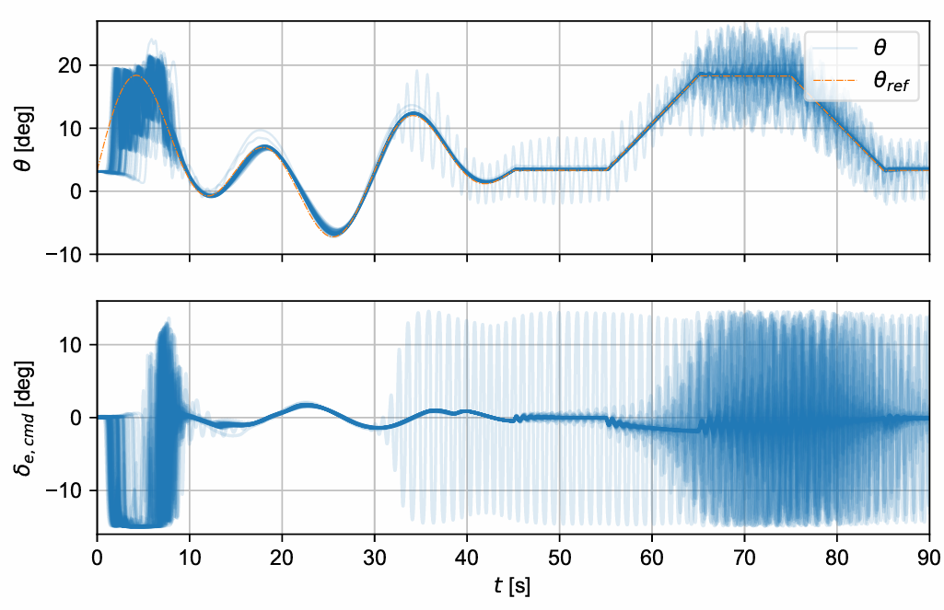
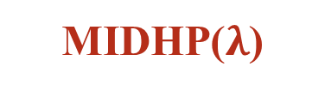
No fault
IDHP
MIDHP($λ$)
Notes:
Move on to next slide for more objective discussion

Slide 32
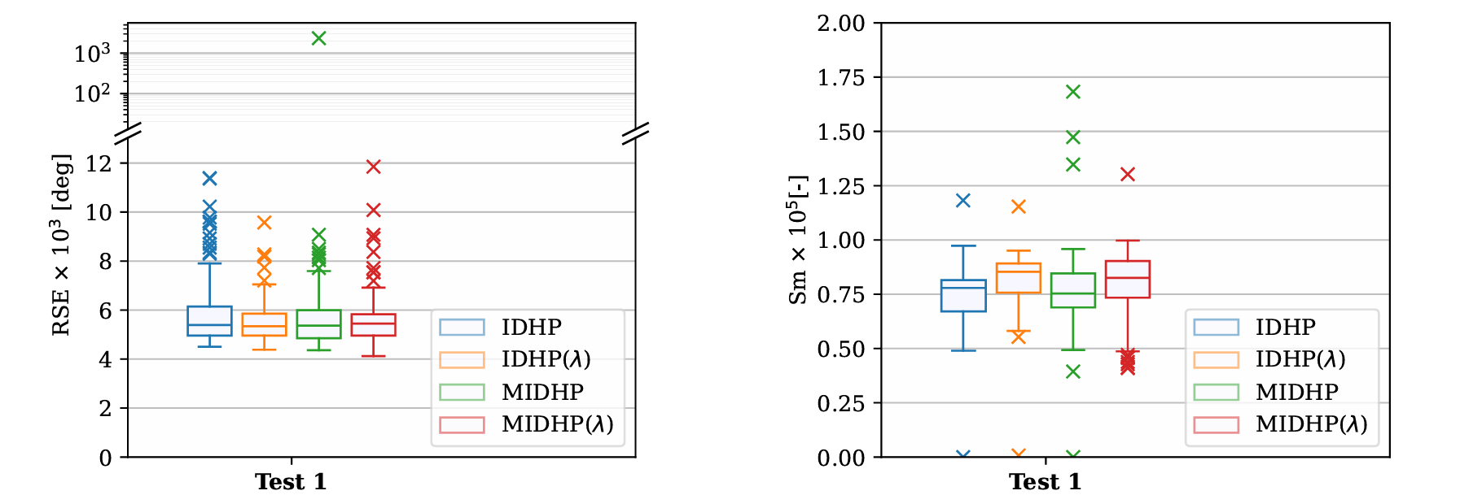
Test 1, RSE & Sm
    For a more objective comparison, and to save on time, we look at the five tests
    Warmup:
Notes:
So in these graphs, I have plotted the RSE and Sm values for each of the algorithms on all 100 flights for the relevant phase

Slide 33
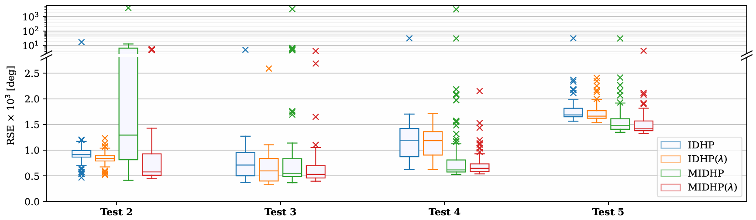
Test 2-5, RSE
    For a more objective comparison, and to save on time, we look at the five tests
    Manoeuvre with (no)fault:

Slide 34
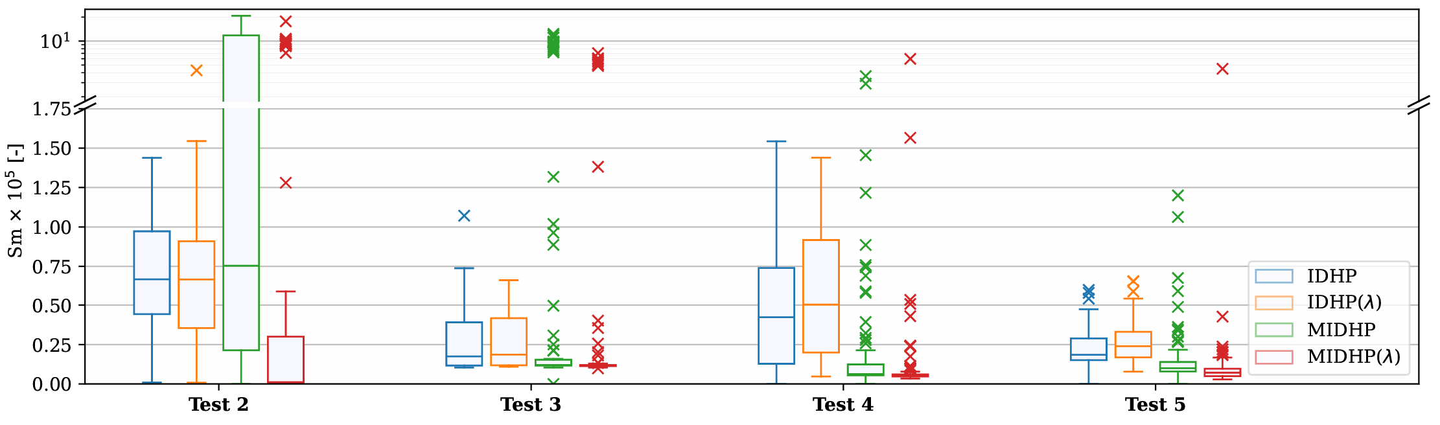
Test 2-5, Sm
    For a more objective comparison, and to save on time, we can look at the RSE and Sm values.
    Manoeuvre with (no)fault:
Notes:
Faults had a smoothening effect on the agents, especially notable in the multi-step algorithms

Slide 35
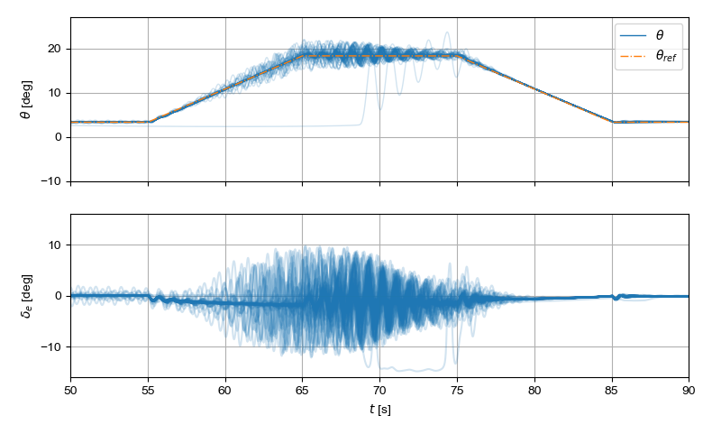
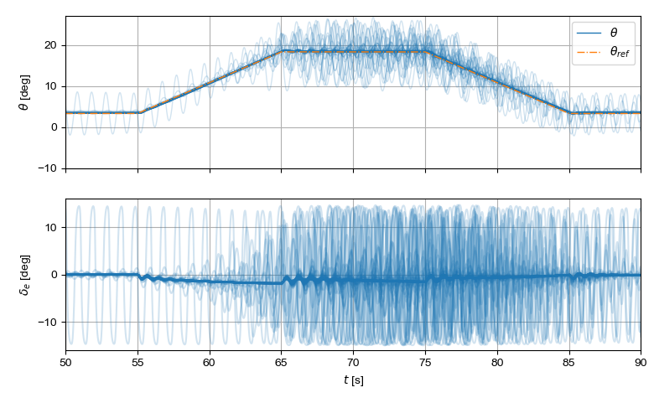
Test 2- Manoeuvre with no fault
IDHP
MIDHP($λ$)

Slide 36
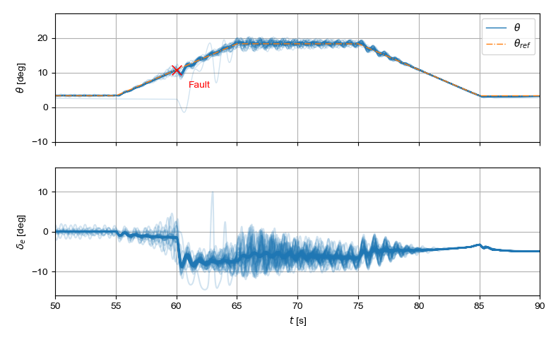
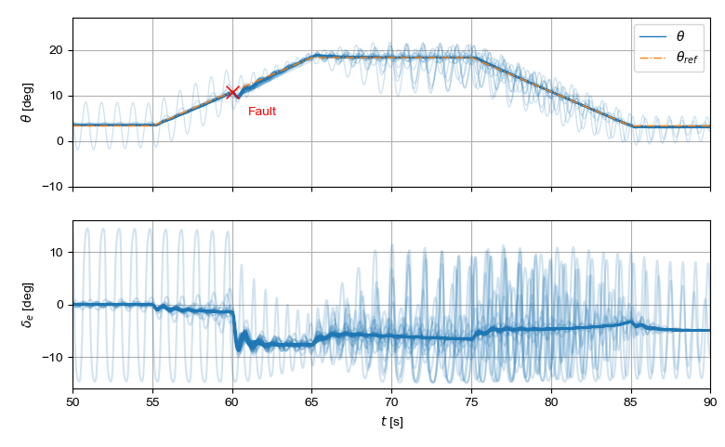
Test 3- Manoeuvre with shift in CG
IDHP
MIDHP($λ$)
Notes:
Now we plot the time traces zoomed in on the manoeuvring phase.

Slide 37
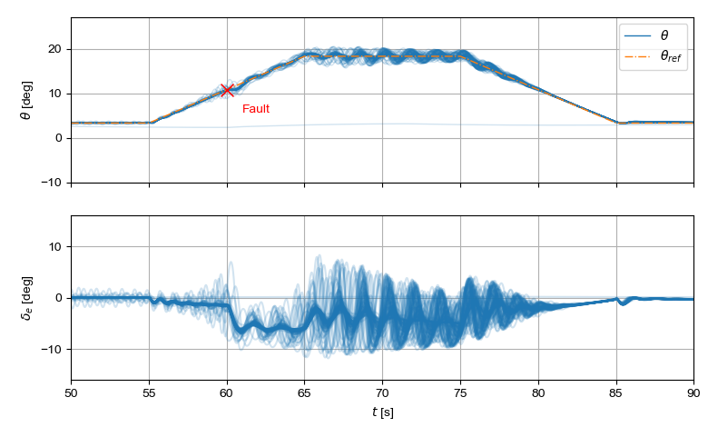
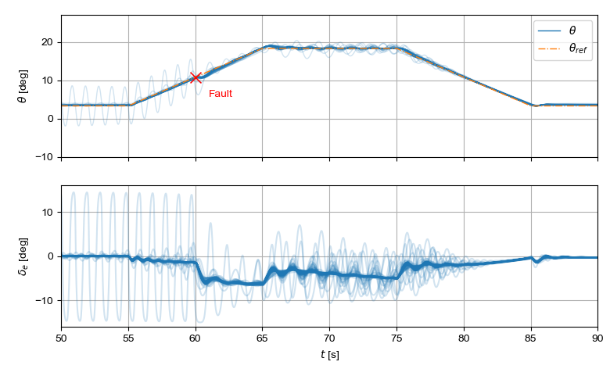
Test 4- Manoeuvre with damaged elevator
IDHP
MIDHP($λ$)

Slide 38
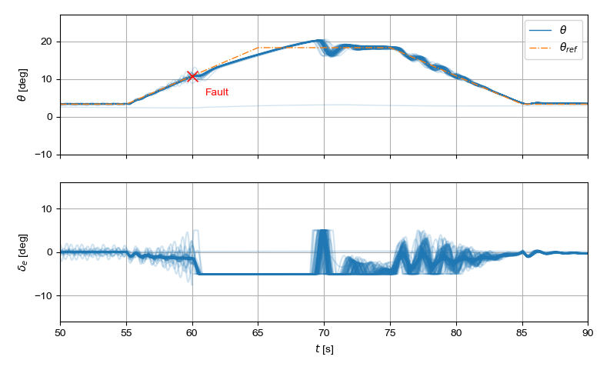
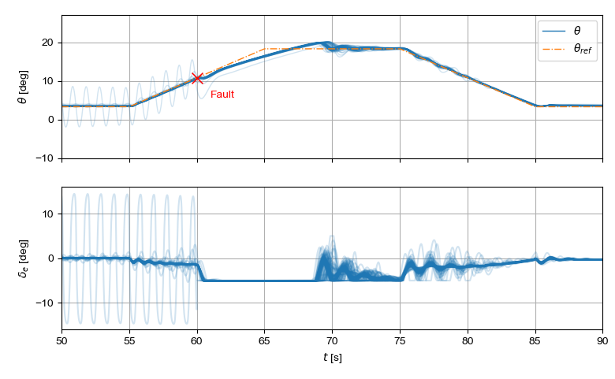
Test 5- Manoeuvre with damaged and saturated elevator
IDHP
MIDHP($λ$)

Slide 39
Chapter | dark mode
05
06
Conclusions

Slide 40
Research Questions
1. What promising reinforcement learning algorithm for fault-tolerance and tracking performance should be further studied in the present research?
Answer: IDHP
2. How can the identified algorithm be applied to control the PH-LAB research aircraft?
Answer: Flight control MDP
3. How does the developed flight controller perform during nominal flight and in the presence of faults?
Answer: Improvement in fault tolerance, not much so in nominal flight.
Notes:
IDHP best, but SAC and TD3 shows promise
Restate the flight control system/flight control problem as an MDP
Tests 3 through 5 shows better fault tolerance, tests 1 and 2 shows no to some improvement in nominal flight.

Slide 41
Closing Remarks & Recommendations
    IDHP improved through augmentations.
    Action smoothness: challenging for IDHP
    More work needed, use alternative action spaces (Dally et al. 2021), genetic operator (Gavra et al. 2023)?
Notes:
This thesis improved the IDHP algorithm by augmenting it with elig and ms, which shows noticeable improvement in fault tolerance.
In spite of using L_CAPS, action still not smooth!
… circling back to the personal motivations I had in picking this topic, if we do want self learning controllers recovering our airplanes when Loss of control incidents occur, working on this issue of oscillatory agent actions will need to be at a high priority.

Slide 42
Q&A

Slide 43
Afsluiter
Thanks For Your Attention
Wing Chan

Slide 44
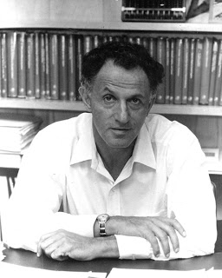
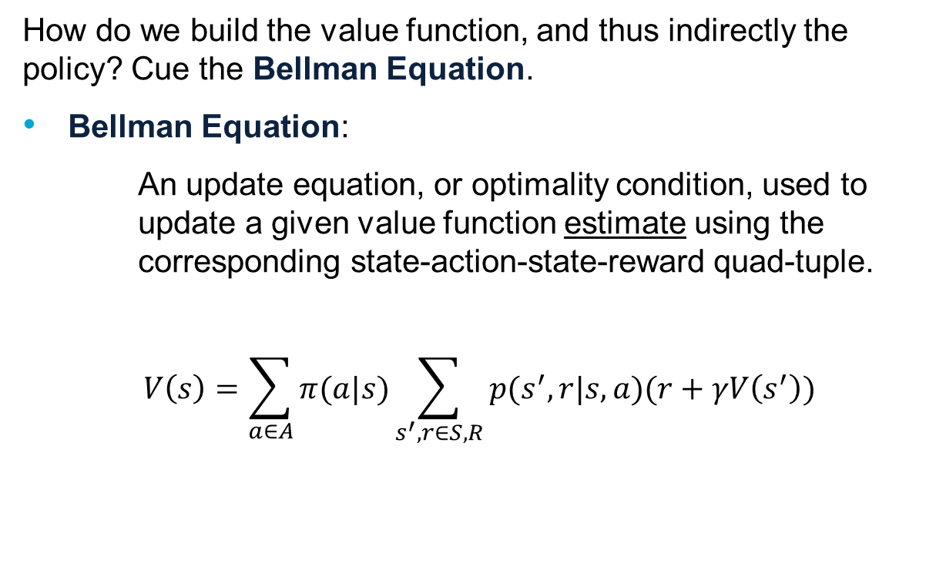
Reinforcement Learning
How do we build the value function, and thus indirectly the policy? Cue the Bellman Equation.
Bellman Equation:
An update equation, or optimality condition, used to update a given value function estimate using the corresponding state-action-state-reward quad-tuple.
$$V\left(s\right)=\sum_{a∈A}{π(a|s)\sum_{s^{′},r∈S,R}{p(s^{′},r|s,a)(r+γV\left(s^{′}\right))}}$$
Richard E. Bellman

Slide 45
RL for Flight Control
    Integrating RL algorithm into flight control = integrating auto-pilot into flight control.
    Flight control variables RL variables
Aircraft States
Control Commands
Tracking Error
MDP State
MDP Actions
MDP Reward

Slide 46





IDHP
Incremental Dual Heuristic Programming
Model-Based vs Model-Free
Value-Based vs Policy-Based
On-Policy vs Off-Policy
Online vs Offline Learning

Slide 47
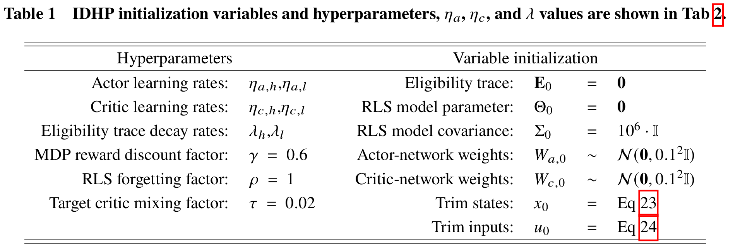
Algorithm initialization

Slide 48
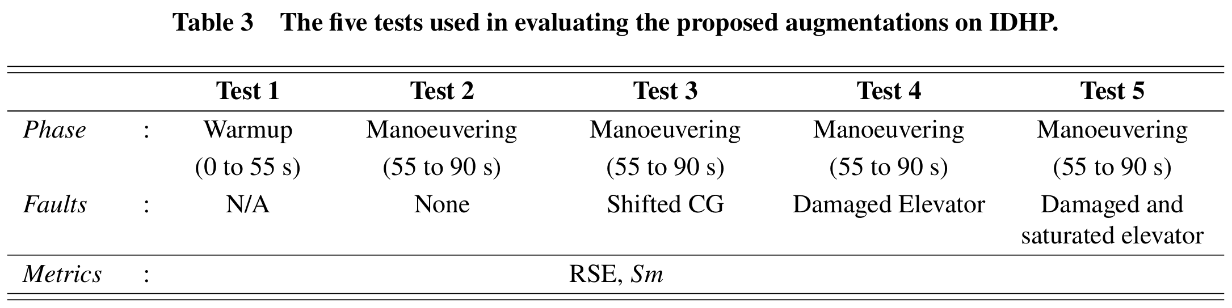
Evaluations
    Criteria:
    Tracking error (RSE), Action smoothness (Sm)
    Test 1:
    How do the algorithms compare during initial learning?
    Test 2-5:
    How do the algorithms compare in terms of fault tolerance?

Slide 49
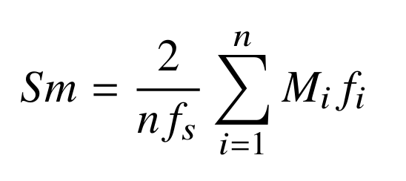

Sm Equation
Where $M_{i}$ is the amplitude of the 𝑖-th frequency component $f_{i}$ where 𝑖 ∈ [1,𝑛], with 𝑛 the number of frequency components sampled, and $f_{S}$ = 100 being the sampling frequency in the time domain.
Notes:
Where 𝑀𝑖 is the amplitude of the 𝑖-th frequency component 𝑓𝑖 where 𝑖 ∈ [1,𝑛], with 𝑛 the number of frequency components sampled, and 𝑓𝑠 = 100 being the sampling frequency in the time domain. Calculating 𝑆𝑚 is done by first taking the Fourier transform of 𝛿𝑒 from the concerned flight phase, and then using the obtained spectrum

Slide 50
Results, Test 1
    For a more objective comparison, and to save on time, we can look at the RSE and Sm values.
    Warmup:

Slide 51
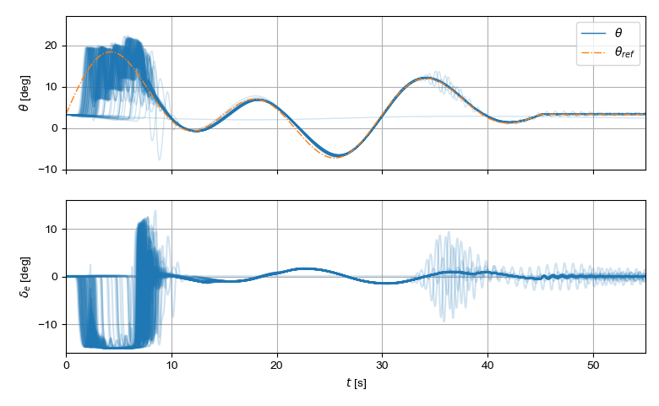
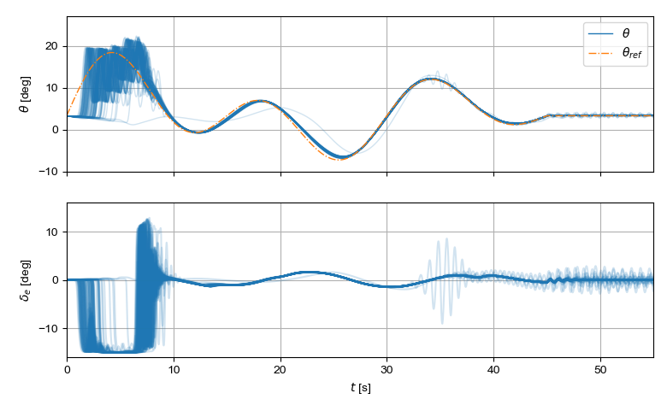
Test 1- Warmup
IDHP
IDHP($λ$)
Notes:
The baseline IDHP flies and learns a stable controller pretty well in the warmup phase. But, when we move to the manoeuvre, and ask it to hold a 15 degree pitch, its actions start to become shakey, which lasts for most of the time while the nose is up, but goes away ones we command the airplane to fly level again.

Slide 52
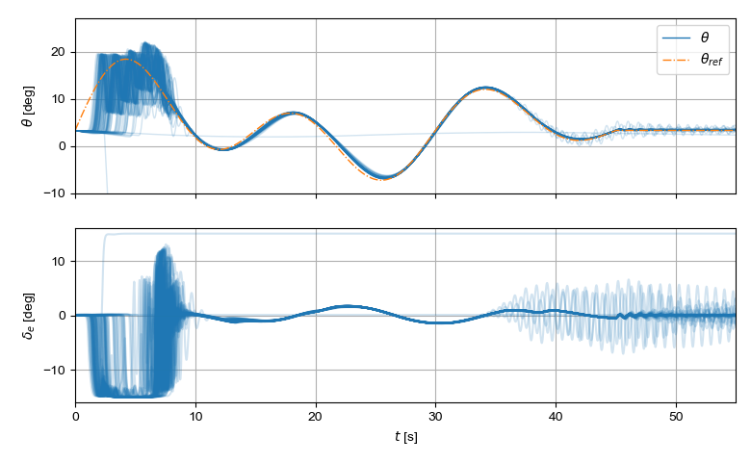
Test 1- Warmup
IDHP
MIDHP
Notes:
The policy which MIDHP arrives at here seems to be much more liberal at using the maximum and minimum elevator deflections, this is an indication that the controller is “high gain”, which makes the control actions more aggressive. This is something which is mitigated when eligibility traces is introduced to the actor.

Slide 53
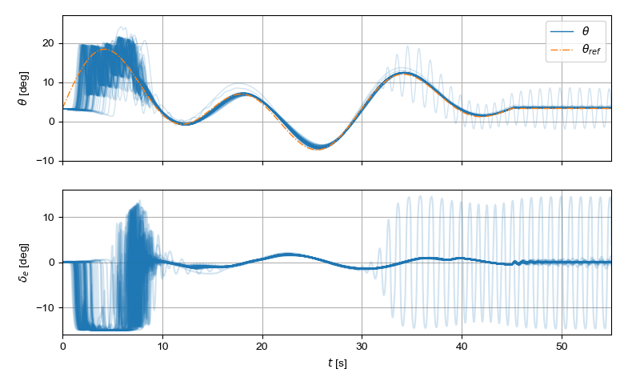
Test 1- Warmup
IDHP
MIDHP($λ$)

Slide 54
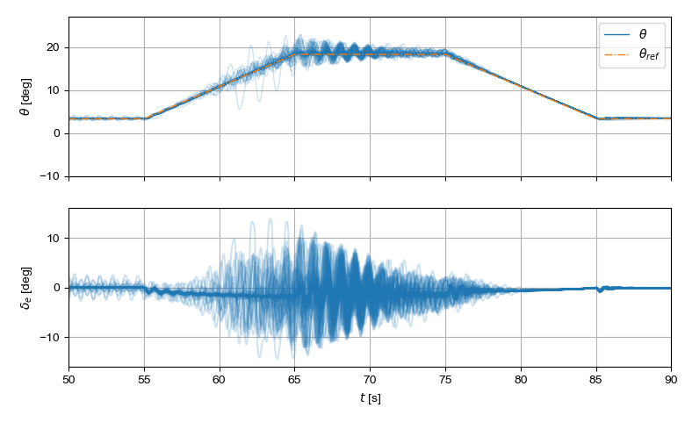
Test 2- Manoeuvre with no fault
IDHP
IDHP($λ$)

Slide 55
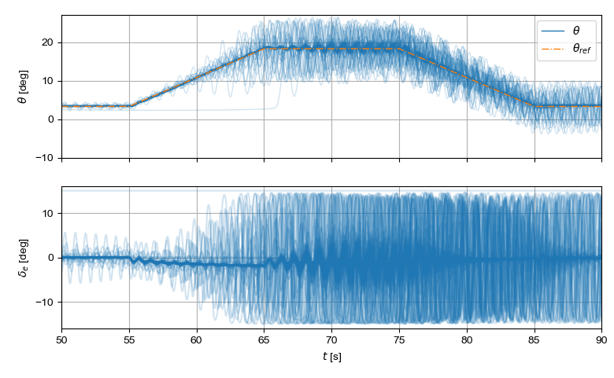
Test 2- Manoeuvre with no fault
IDHP
MIDHP

Slide 56
Test 2- Manoeuvre with no fault
IDHP
MIDHP($λ$)

Slide 57

Test 3- Manoeuvre with shift in CG
IDHP
IDHP($λ$)

Slide 58

Test 3- Manoeuvre with shift in CG
IDHP
MIDHP

Slide 59
Test 3- Manoeuvre with shift in CG
IDHP
MIDHP($λ$)

Slide 60

Test 4- Manoeuvre with damaged elevator
IDHP
IDHP($λ$)

Slide 61

Test 4- Manoeuvre with damaged elevator
IDHP
MIDHP

Slide 62
Test 4- Manoeuvre with damaged elevator
IDHP
MIDHP($λ$)

Slide 63

Test 5- Manoeuvre with damaged and saturated elevator
IDHP
IDHP($λ$)

Slide 64

Test 5- Manoeuvre with damaged and saturated elevator
IDHP
MIDHP

Slide 65
Test 5- Manoeuvre with damaged and saturated elevator
IDHP
MIDHP($λ$)

